Slide 1

Web Fundamentals Project
How does the web work?
What do you need to be a web developer?
Why did you choose to learn web development?

Slide 2
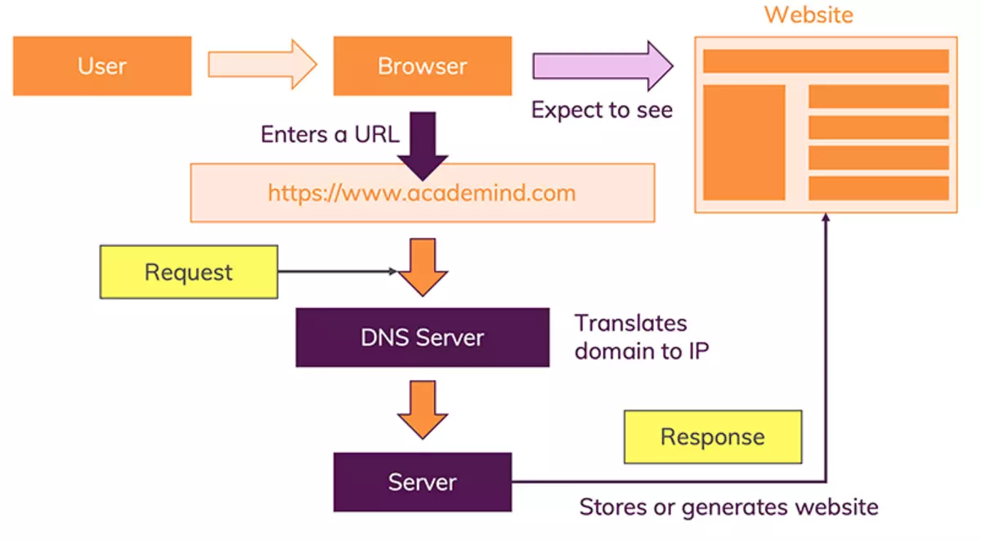
1-How does the web work?

Slide 3
First step: The request is sent.
The process begins when your browser sends a request to the web server that hosts a web page. The most important item in that request is the URL, or Uniform Resource Locator. The URL includes:
Everything before the first slash is the domain name, this identifies the host.
Everything after the first slash tells the hosting server what specific resource you are looking for.

Slide 4
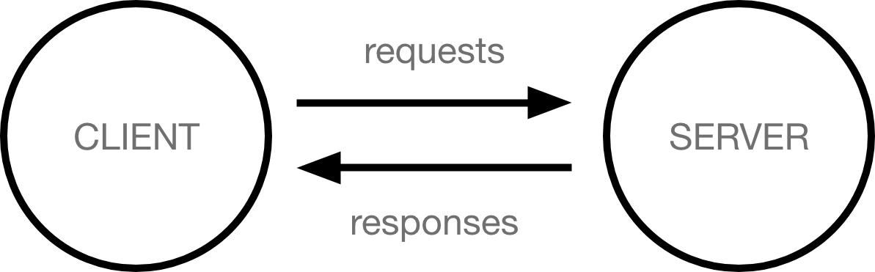

Slide 5
Second step: The server responds.
Next, the web hosting server responds to the request. If the request is successful, the response will include the contents of the file (resource) your browser asked for. If there is a problem with the request, or with the server, the response will be an error code.
Once the website resources have been received from the server, your browser begins processing and displaying the response. Often, the returned page (document) contains links to other resources (files) which the browser will need in order to display the page properly:

Slide 6
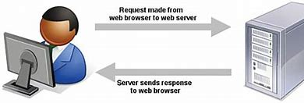
Images, video, or other media which should appear on page
CSS style sheets which tell the browser how to style the document
JavaScript files which provide some on-page functionality
For each of these additional files, the browser makes an additional request, and the server responds. If the requests are successful, the server returns the needed files.

Slide 7
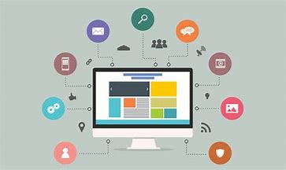
Third Step: The website is displayed.
The browser displays the original document, with the additional resources. Within most pages are hyperlinks to other documents or pages — if you click on one, the whole process starts all over again.

Slide 8

2-What do you need to be a web developer?

Slide 9

Build web developer skills.
Employers and clients usually expect web developers to have certain skills that demonstrate their ability to deliver on website requirements. If you’re interested in a career as a web developer, these are some skills you can focus on to build a foundation for success.

Slide 10
Technical skills
Workplace skills
Coding
Responsive design
Technical SEO
Version control
Visual design
Communication
Customer service
Detail-oriented
Problem solving
Organization

Slide 11
Consider a degree in computer science or web design
While you don’t always need a degree to get a job in web development, it can certainly help. If you’re already in school (or considering earning a degree), some majors might be a better fit for your career goals than others. If you’re more interested in back-end web development, consider a degree program in computer sciences,

Slide 12
Take a course in web development.
You don’t necessarily need formal training to work as a web developer. It’s possible to acquire the skills you need on your own. For example, you can take a course to learn programming languages like HTML, JavaScript, or CSS, and then put what you learn into practice on your own website.

Slide 13
Build a portfolio of web development work.
As a web developer, your portfolio is often one of the most important parts of your resume. This collection of projects shows potential employers what you’re capable of creating. Include the types of projects that represent the work you’d like to do. If you’re including code, be sure to annotate it to show your thought process.

Slide 14
Why did you choose to learn web development?
Career Opportunities
Freelancing and Remote Work
Entrepreneurship
Learning Problem-Solving
Creativity and Innovation
Freelancing and Remote Work

Slide 15


Slide 16


